Slide 1
University of Diyala
College of Engineering
Department of Electronics Engineering
Course Number: U103
Course Name: Computer Science
Lecture (10)
Asst. Lect. Wurod Qasim Mohamed

Slide 2
Microsoft office Access Database

Slide 3
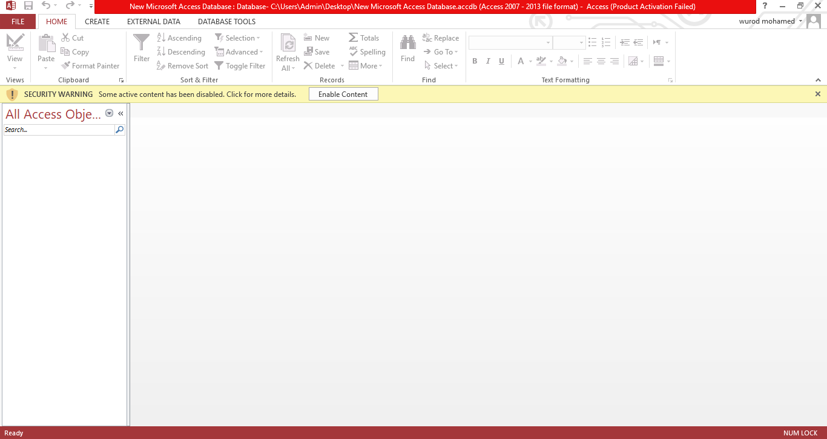

Slide 4
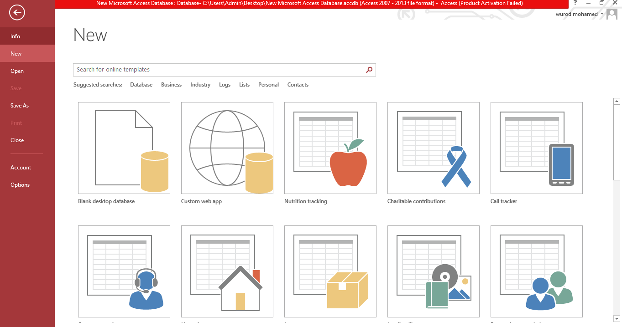

Slide 5
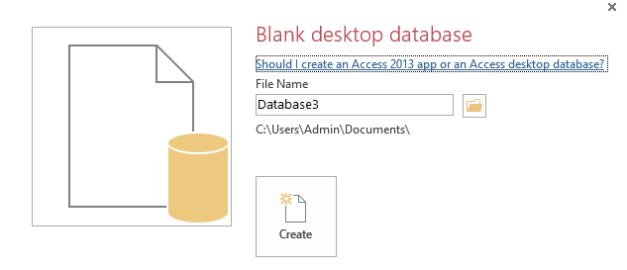

Slide 6
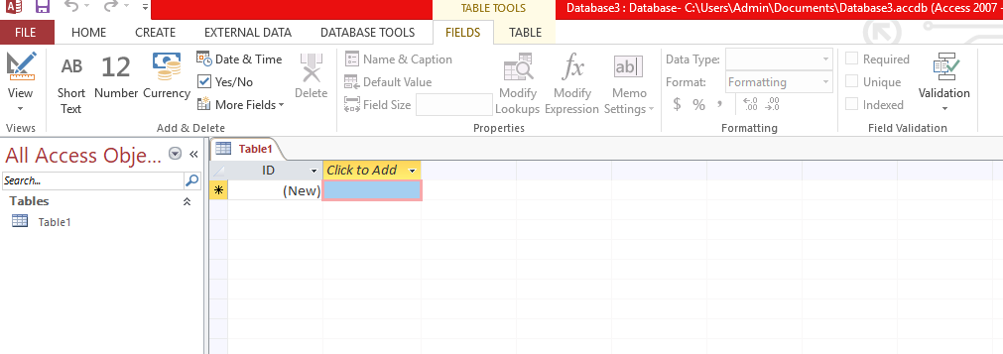

Slide 7
Practical Laboratory Part

